Slide 1
A set of Wireless and Wired Power Transfer Systems
Studies
Enes Ayaz
^{20/10/2022}

Slide 2
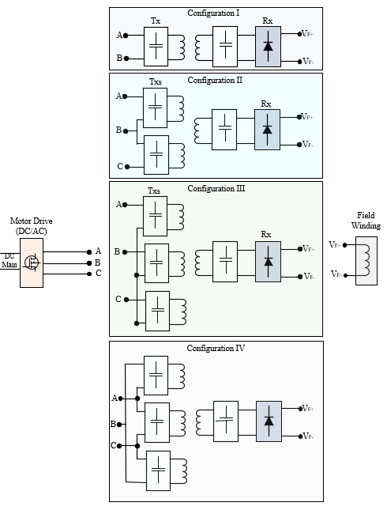
Previously on the 30-min Presentation
Motor drives have more than 2 wires
Conventional WPT systems have 2 wires input
Multi-phase WPT systems
Motivations:
To increase DC-link utilization rate
To increase power
To break the restrictions
Notes:
The WPT system is connected between phase-A and phase B.
By carrier phase shift to phase B, we achieve this contour of the magnitude of the switching frequency.
We can observe that we can have a constant gain for any modulation.
The constant gain is between 0.25 and 0.45 over a DC-link voltage.
The control diagram is shown.
We adjust the carrier phase shift according to modulation to control the WPT power.

Slide 3
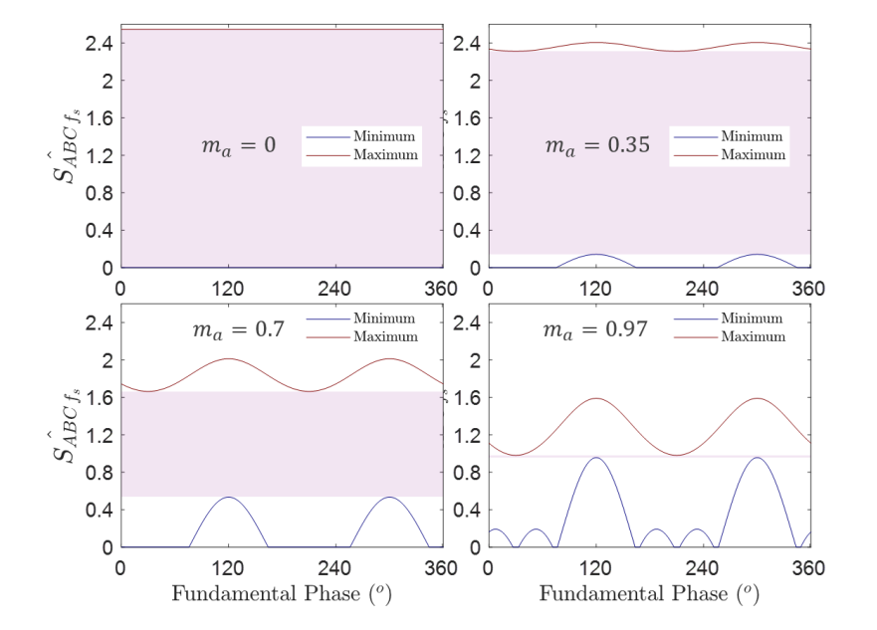
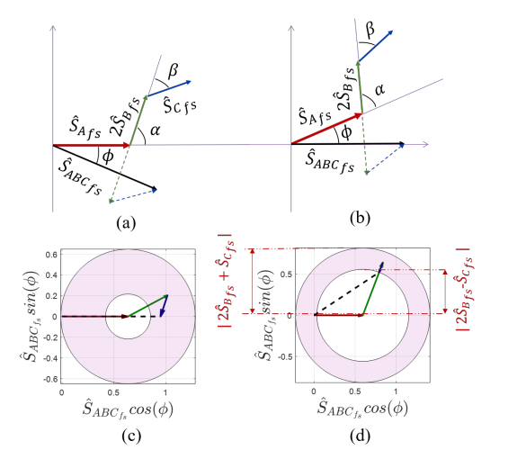
Future Works
Notes:
The WPT system is connected between phase-A and phase B.
By carrier phase shift to phase B, we achieve this contour of the magnitude of the switching frequency.
We can observe that we can have a constant gain for any modulation.
The constant gain is between 0.25 and 0.45 over a DC-link voltage.
The control diagram is shown.
We adjust the carrier phase shift according to modulation to control the WPT power.

Slide 4
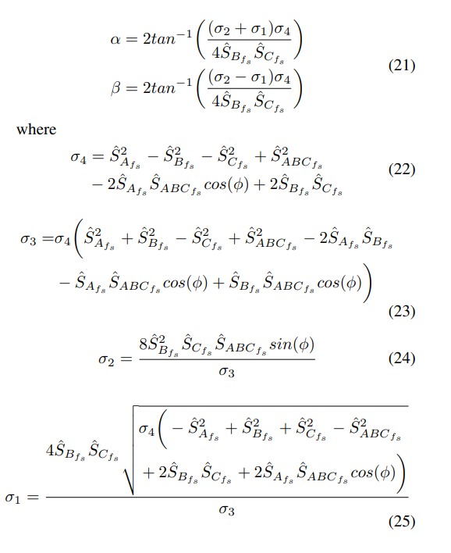
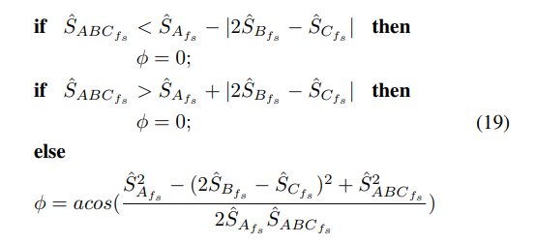
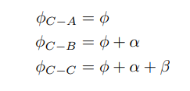
Challenge- Calculation Burden!
Notes:
The WPT system is connected between phase-A and phase B.
By carrier phase shift to phase B, we achieve this contour of the magnitude of the switching frequency.
We can observe that we can have a constant gain for any modulation.
The constant gain is between 0.25 and 0.45 over a DC-link voltage.
The control diagram is shown.
We adjust the carrier phase shift according to modulation to control the WPT power.

Slide 5
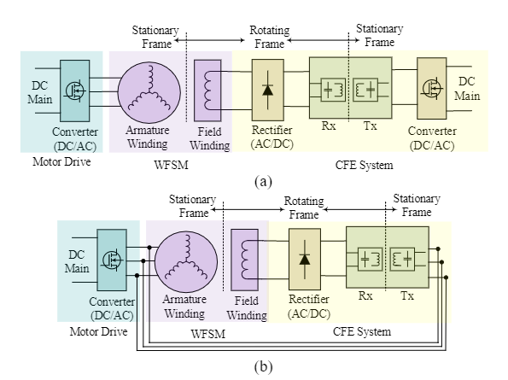
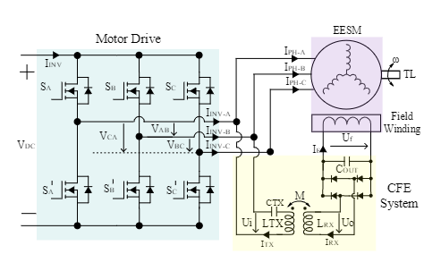
Variable Carrier Phase Shift Method for Integrated Contactless Field Excitation System of Electrically Excited Synchronous Motors
The circuit diagram of a conventional and proposed CFE based on a WPT system for EESMs.
a) The conventional system. b) The proposed system.
The circuit diagram of the proposed system
Notes:
The WPT system is connected between phase-A and phase B.
By carrier phase shift to phase B, we achieve this contour of the magnitude of the switching frequency.
We can observe that we can have a constant gain for any modulation.
The constant gain is between 0.25 and 0.45 over a DC-link voltage.
The control diagram is shown.
We adjust the carrier phase shift according to modulation to control the WPT power.

Slide 6
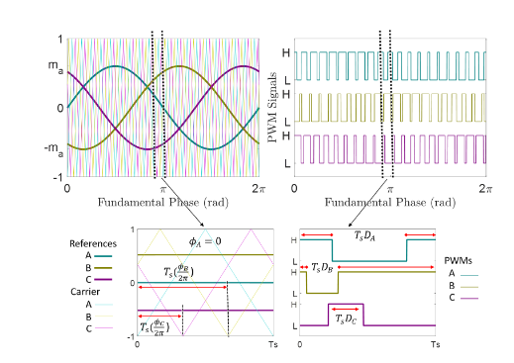
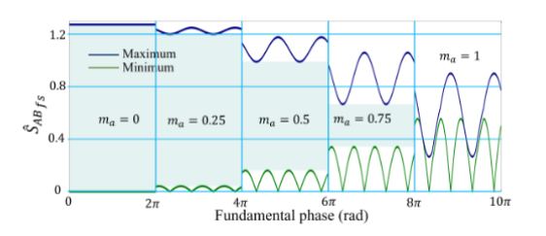
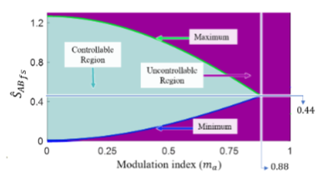
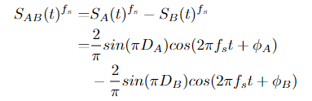
Variable Carrier Phase Shift- Time Domain Analysis

Slide 7
Multifrequency IPT Systems
Standards:
Wireless Power Consortium (WPC)
Power Matters Alliance (PMA)
Alliance for Wireless Power (A4WP)
Motivations:
To Increase power
To reduce switching components
To increase DC-link utilization rate
To provide operation for more than one standards
Some Topologies:
Multi-converter and multi-resonant
Single-converter and multi-resonant
Single-converter and multi-load
100 - 205/300 kHz for magnetic resonant and induction technology for mobile devices; WPT systems for consumer devices, power transfer typically < 200 W; plan to be used worldwide
6765 - 6795 kHz for magnetic resonant technology for mobile devices; WPT systems for consumer devices, power transfer typically < 30 W; plan to be used.
300 - 500 kHz: WPT systems for consumer devices, power transfer typically < 5 W; plan to be used for smaller devices.
900 - 1 000 kHz: WPT systems for consumer devices, power transfer typically < 5 W; plan to be used for smaller devices.
Notes:
The WPT system is connected between phase-A and phase B.
By carrier phase shift to phase B, we achieve this contour of the magnitude of the switching frequency.
We can observe that we can have a constant gain for any modulation.
The constant gain is between 0.25 and 0.45 over a DC-link voltage.
The control diagram is shown.
We adjust the carrier phase shift according to modulation to control the WPT power.

Slide 8
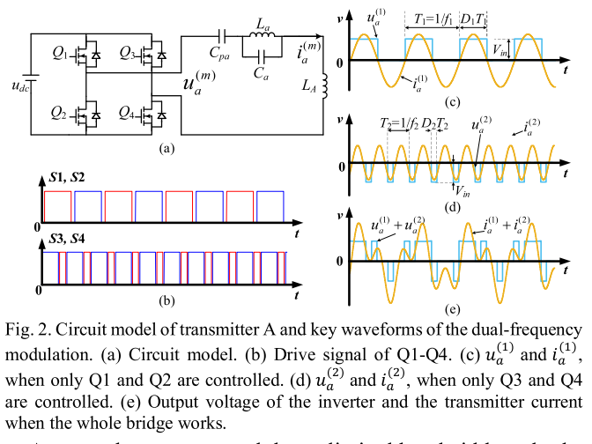
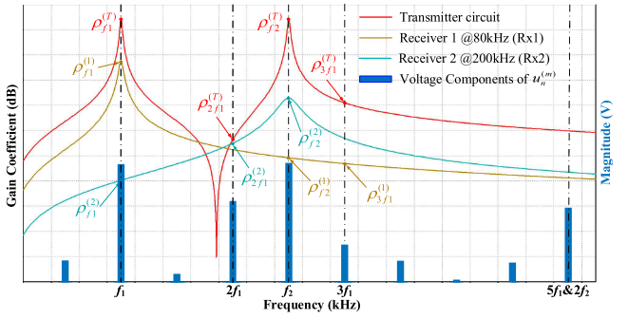
Narrowband Concurrent Wireless Power Transfer (For use of single standard range)
A Dual-Frequency Three-Dimensional WPT System with Directional Power Transfer
Capability at Two Separately Regulated Outputs
Notes:
The WPT system is connected between phase-A and phase B.
By carrier phase shift to phase B, we achieve this contour of the magnitude of the switching frequency.
We can observe that we can have a constant gain for any modulation.
The constant gain is between 0.25 and 0.45 over a DC-link voltage.
The control diagram is shown.
We adjust the carrier phase shift according to modulation to control the WPT power.

Slide 9
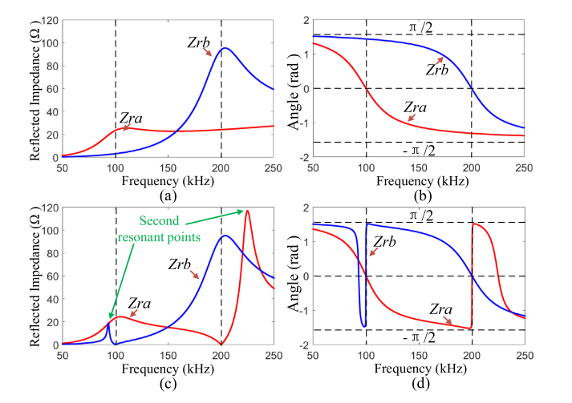
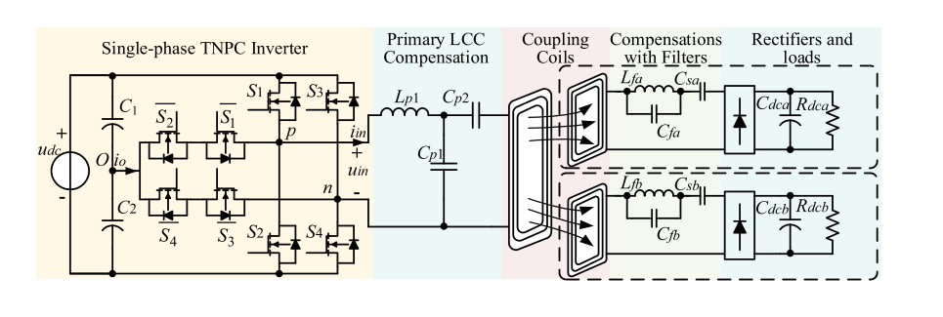
Narrowband Concurrent Wireless Power Transfer (For use of single standard range)
Design and Control of a Decoupled Multichannel Wireless Power Transfer System Based on Multilevel Inverters

Slide 10
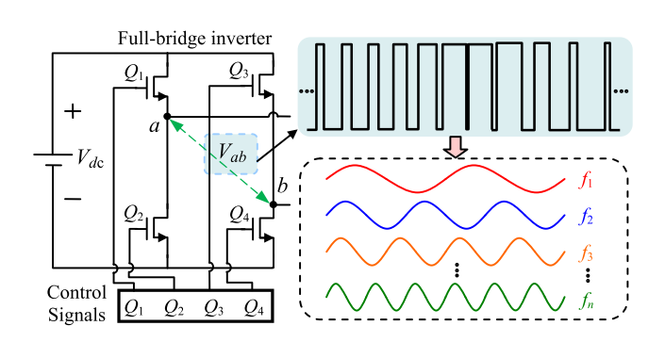
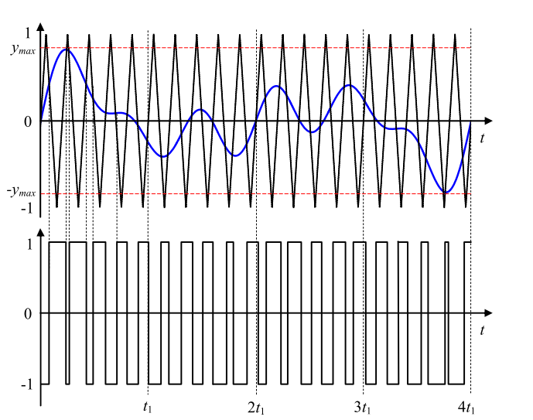
Narrowband Concurrent Wireless Power Transfer
Multi-Frequency Multi-Amplitude Superposition Modulation Method With Phase Shift Optimization for Single Inverter of Wireless Power Transfer System

Slide 11
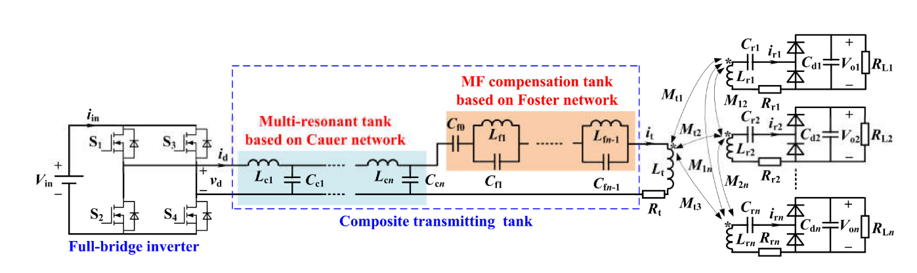
Wideband Concurrent Wireless Power Transfer
Multi-Frequency Multi-Amplitude Superposition Modulation Method With Phase Shift Optimization for Single Inverter of Wireless Power Transfer System

Slide 12
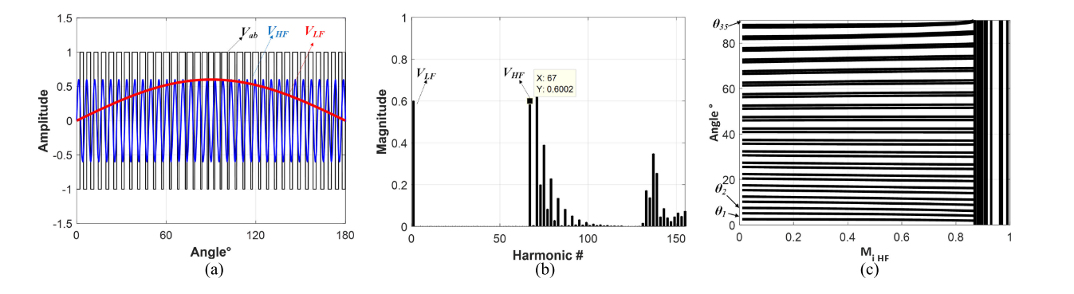
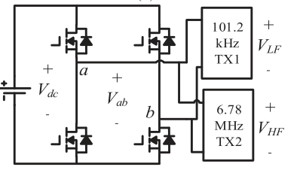
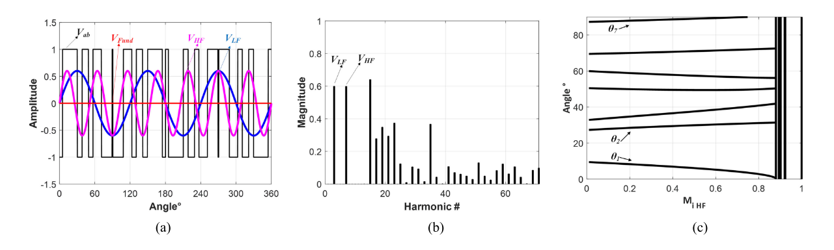
Narrowband / Wideband Concurrent Wireless Power Transfer
GaN-Based Dual-Mode Wireless Power Transfer Using Multifrequency Programmed Pulse Width Modulation

Slide 13
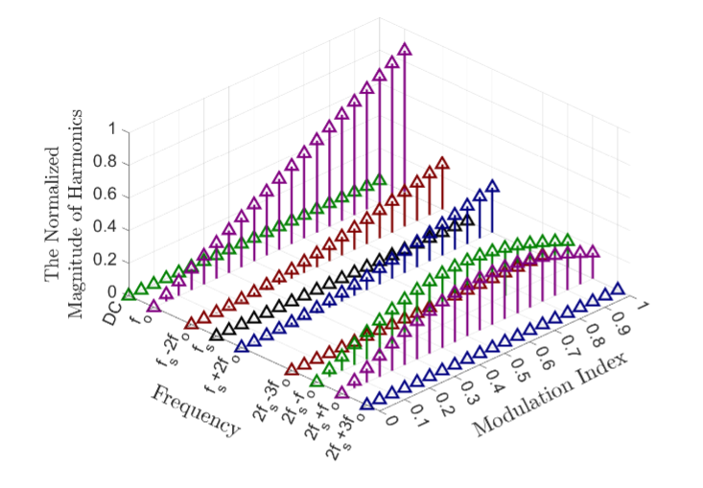
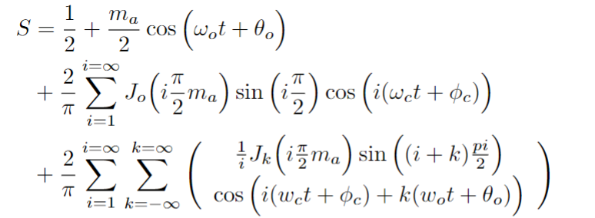
Narrowband and Wideband Concurrent Wireless Power Transfer using a Single Transmitter
SPWM
Notes:
The WPT system is connected between phase-A and phase B.
By carrier phase shift to phase B, we achieve this contour of the magnitude of the switching frequency.
We can observe that we can have a constant gain for any modulation.
The constant gain is between 0.25 and 0.45 over a DC-link voltage.
The control diagram is shown.
We adjust the carrier phase shift according to modulation to control the WPT power.

Slide 14



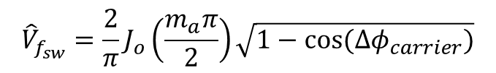






Wideband Concurrent Wireless Power
$$f_{sh}=6980 kHz$$
Control parameters :
Modulation index
Carrier phase shift
$$f_{sl}=6580 kHz$$
$$f_{sw}=6780 kHz$$
$$f_{o}=100 kHz$$
$$f_{0}$$
$$f_{sl}$$
$$f_{sw}$$
$$f_{sh}$$
$${\hat{V}}_{f_{0}}=m_{a}$$
$${\hat{V}}_{f_{sw}}=\frac{2}{π}J_{o}\left(\frac{m_{a}π}{2}\right)\sqrt{1−cos⁡({Δφ}_{carrier})}$$

Slide 15



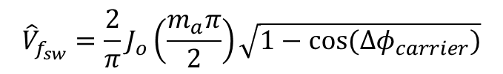





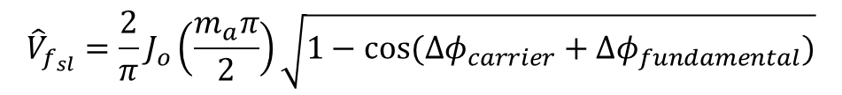




Narrowband Concurrent Wireless Power
$$f_{o}=120 kHz$$
$$f_{o}=80 kHz$$
$$f_{o}=160 kHz$$
Control parameters :
Modulation index
Carrier phase shift
Fundamental phase shift
$$f_{o}=20 kHz$$
$$f_{0}$$
$$f_{sl}$$
$$f_{sw}$$
$$f_{sh}$$
$${\hat{V}}_{f_{sw}}=\frac{2}{π}J_{o}\left(\frac{m_{a}π}{2}\right)\sqrt{1−cos⁡({Δφ}_{carrier})}$$
$$f_{0}=20 kHz$$
$$f_{sh}=160 kHz$$
$${\hat{V}}_{f_{sl}}=\frac{2}{π}J_{o}\left(\frac{m_{a}π}{2}\right)\sqrt{1−cos⁡({Δφ}_{carrier}+Δφ_{fundamental})}$$
$$f_{sl}=80 kHz$$
$$f_{sw}=120 kHz$$

Slide 16
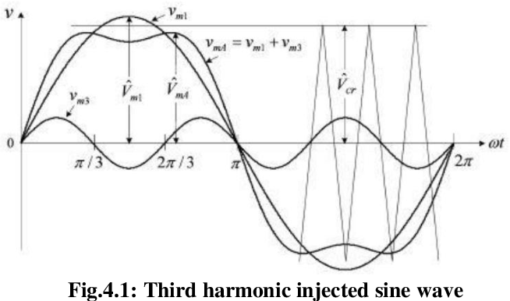















Additional Narrowband/Wideband Concurrent Wireless Power for HB configuration
$$f_{0}$$
$${3f}_{0}$$
$$f_{sl}$$
$$f_{sw}$$
$$f_{sh}$$
$$20$$
$$kHz$$
$$60$$
$$kHz$$
$$80$$
$$kHz$$
$$120$$
$$kHz$$
$$160$$
$$kHz$$
Narrow Band
HB:
It is not possible to introduce carrier or fundamental phase shifts
$$100$$
$$kHz$$
$$300$$
$$kHz$$
$$6680$$
$$kHz$$
$$6780$$
$$kHz$$
$$6880$$
$$kHz$$
Wide Band
Control parameters :
Fundamental modulation index
Harmonic modulation index (3rd , 5th , 7th )

Slide 17
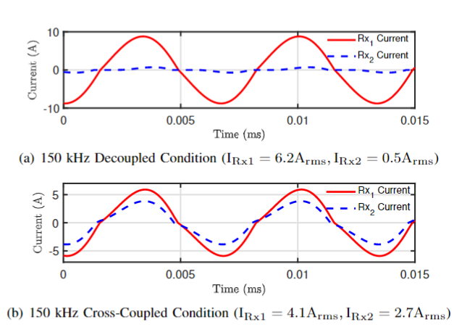
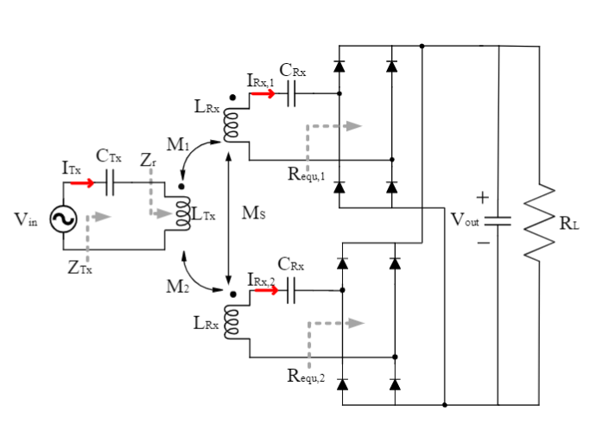
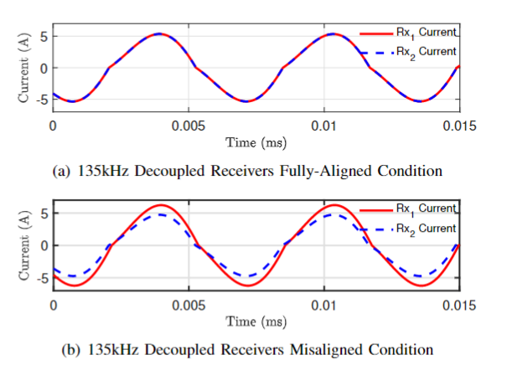
Balancing with Soft-Magnetic Material based Inductors
Intentional de-tuning of the receiver resonant tank for unbalanced modules
Notes:
The WPT system is connected between phase-A and phase B.
By carrier phase shift to phase B, we achieve this contour of the magnitude of the switching frequency.
We can observe that we can have a constant gain for any modulation.
The constant gain is between 0.25 and 0.45 over a DC-link voltage.
The control diagram is shown.
We adjust the carrier phase shift according to modulation to control the WPT power.

Slide 18
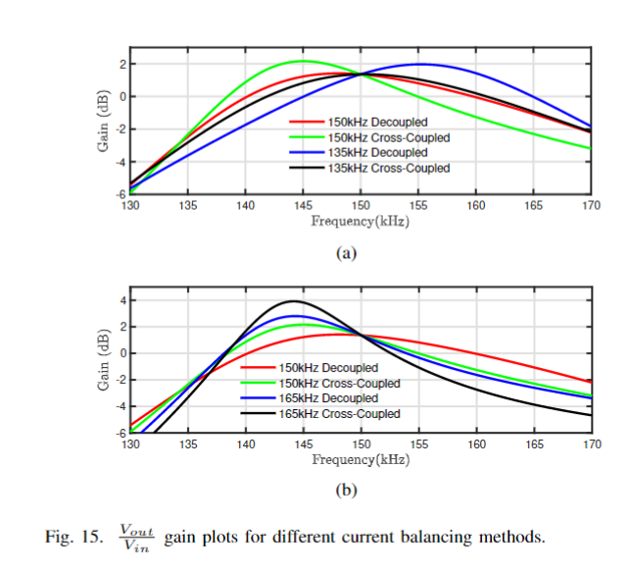
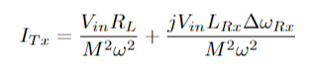
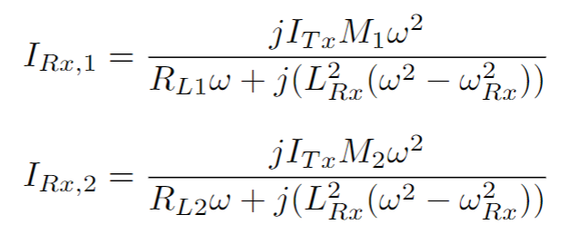
Balancing with Soft-Magnetic Material based Inductors
Notes:
The WPT system is connected between phase-A and phase B.
By carrier phase shift to phase B, we achieve this contour of the magnitude of the switching frequency.
We can observe that we can have a constant gain for any modulation.
The constant gain is between 0.25 and 0.45 over a DC-link voltage.
The control diagram is shown.
We adjust the carrier phase shift according to modulation to control the WPT power.

Slide 19
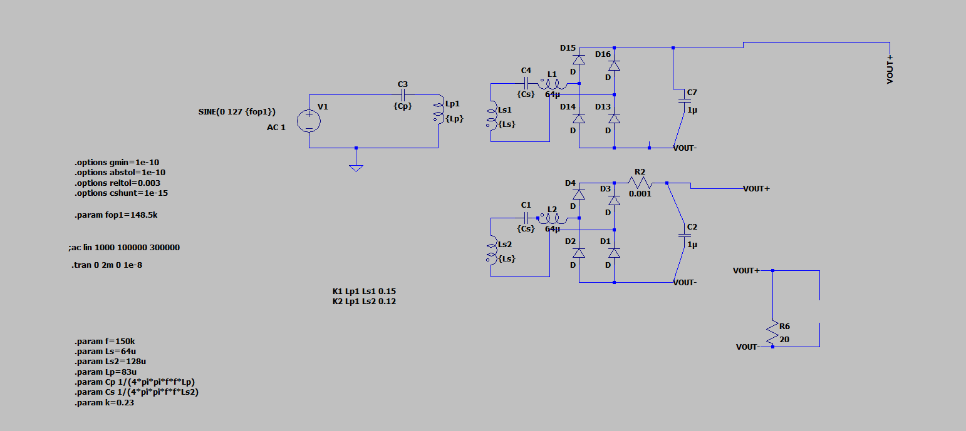
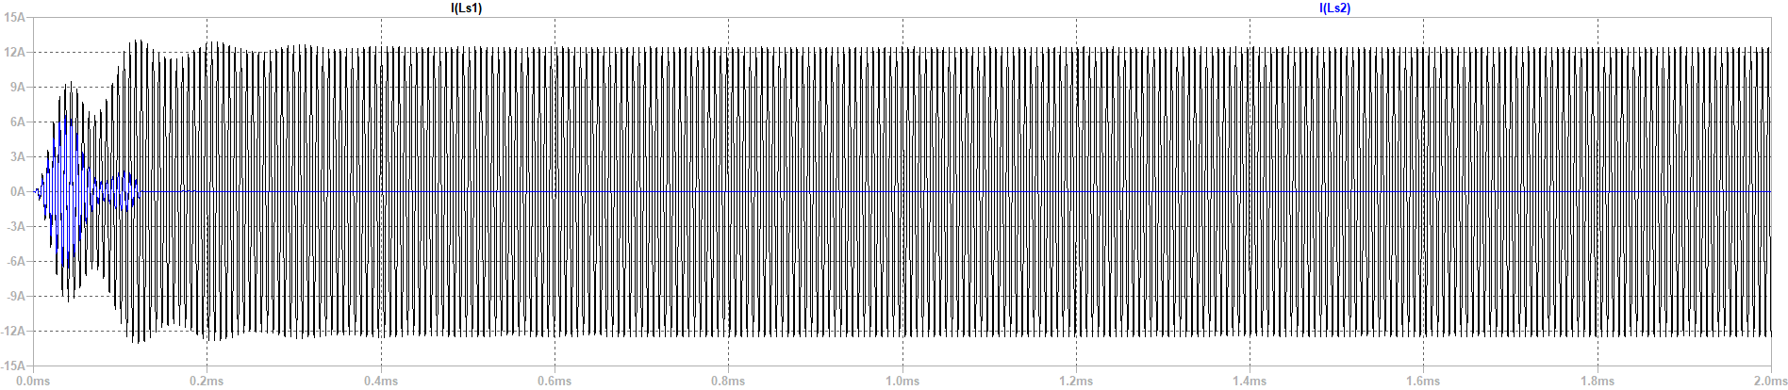

Slide 20
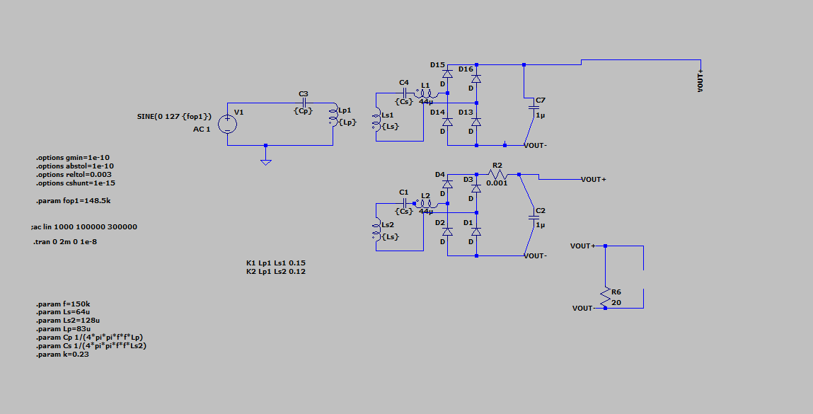
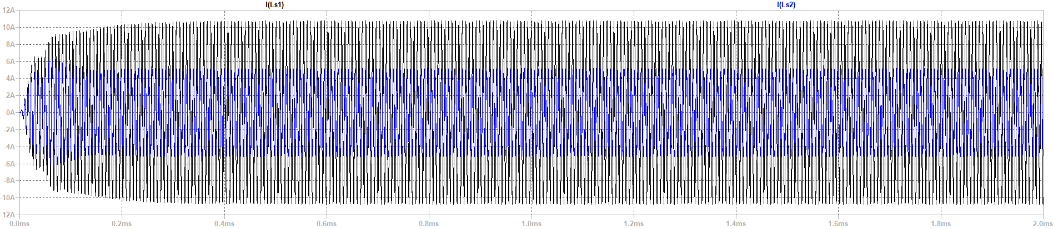

Slide 21
Soft-Magnetic Material based Inductors
Requirement
Saturable Core
Excitation Circuit
Trap Filter
Cost, Size comparison
Notes:
The WPT system is connected between phase-A and phase B.
By carrier phase shift to phase B, we achieve this contour of the magnitude of the switching frequency.
We can observe that we can have a constant gain for any modulation.
The constant gain is between 0.25 and 0.45 over a DC-link voltage.
The control diagram is shown.
We adjust the carrier phase shift according to modulation to control the WPT power.

Slide 22
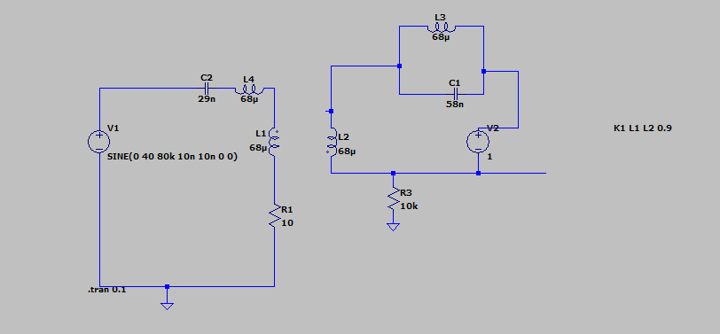
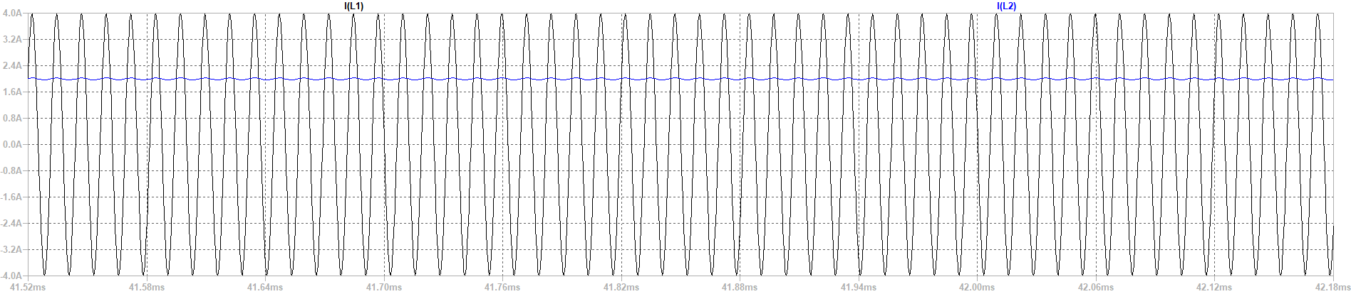

Slide 23

Soft-Magnetic Material based Inductors without additional converter

Slide 24


Slide 25
Future Works
1- Synchronous motor journal : Written, but some experimental results are needed.
2- Preparing Wide/narrow bandgap wireless power transfer journal draft :
Literature Review (almost made)
Analytic modelling :
SPWM is ready
SPWM with additional harmonic is standing
Experimental setup:
Find Of-the-shelf inductance for the story
Power is about 30W to 5W
6.78 MHz with 80kHz-200kHz or 900kHz-1000kHz with 80kHz-200KHz
3-Preparing Balancing journal draft ( we can focusTPEL special section about high power and misalingment)
Discussions to get into focus
High power, series/parallel connection
Cost and feasibility
Notes:
The WPT system is connected between phase-A and phase B.
By carrier phase shift to phase B, we achieve this contour of the magnitude of the switching frequency.
We can observe that we can have a constant gain for any modulation.
The constant gain is between 0.25 and 0.45 over a DC-link voltage.
The control diagram is shown.
We adjust the carrier phase shift according to modulation to control the WPT power.

Slide 26
Thanks!

